Slide 2


Peer-mobilized HIV self-testing increases case detection and linkage to ART among key populations in Burundi
Dismas Gashobotse, MD
FHI 360/LINKAGES, Burundi
@LINKAGESproject
Share your thoughts on this presentation with #IAS2019

Slide 3
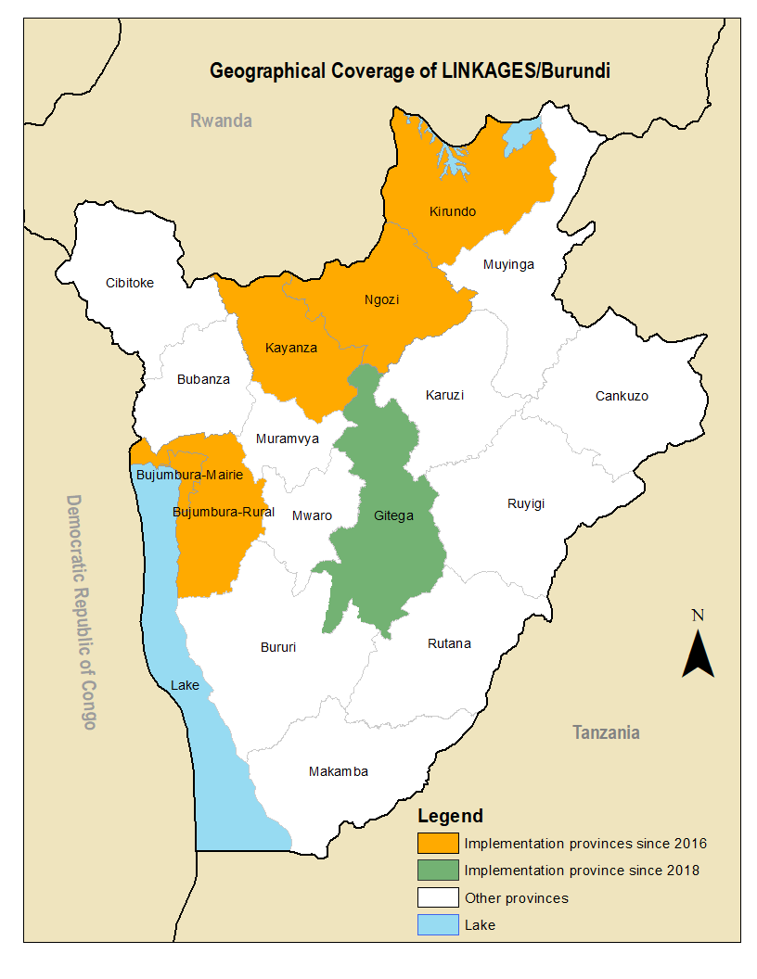
Background
LINKAGES is a global project funded by USAID/PEPFAR working in 30 countries to address the HIV prevention, care, and treatment needs of key populations (KPs)—female sex workers (FSWs), men who have sex with men (MSM), transgender people, and people who inject drugs
LINKAGES has been working in Burundi since August 2016; currently in six provinces

Slide 4
HIVST background in Burundi
LINKAGES began implementing directly assisted, peer-mediated HIV
self-testing (HIVST) in June 2018 in three provinces
Extended HIVST activities to three additional provinces in December 2018
By the end of March 2019:
2321 test kits have been used
389 kits have been reactive
326 confirmed positive (14% case-finding)
312 initiated on ART (96% ART initiation)

Slide 5
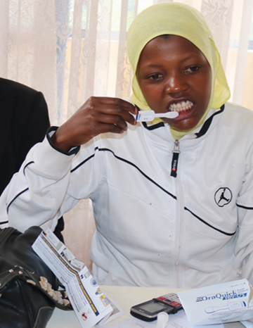
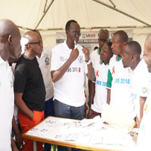
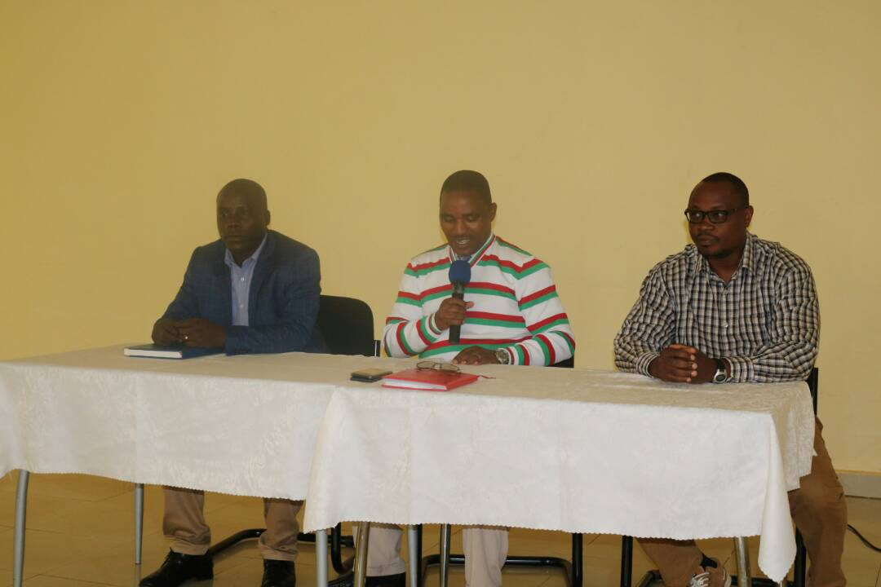
Creating demand
HIVST adopted in the 2016 Burundi National Guidelines
Risk assessment tool developed
KP community consultations held
Peers and health care providers trained to offer and assist with HIVST
Sensitization workshops held targeting MOH officials, local administration, and health care providers
HIVST launched by MOH for 2018 World AIDS Day
Video demonstrating how to use Oraquick produced in the local language
Evaluation conducted after one month of implementation to identify and address gaps

Slide 6








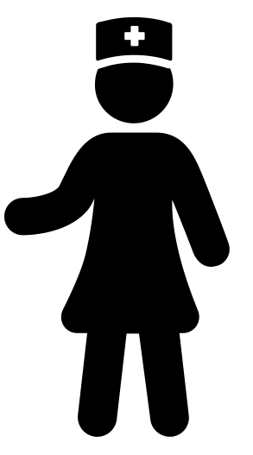
Community approach for HIVST
Peer-facilitated testing
RESULTS
Peer outreach worker provides test kit
Test reactive:
Referral to DIC or
HTC services for confirmatory test
Linked to Care and Treatment services
Uptake
of HIV self-testing using Ora Quick
Private testing
at preferred location
Clients reached through regular outreach activities
Private testing
at DIC
Test nonreactive:
Advise for re- test in
3 months or refer for prevention services
Continued engagement in HIV prevention and link to PrEP, VMCC as appropriate
Drop in center based testing
DIC staff- facilitated
testing

Slide 7
FSW HIVST cascade (June 2018 to March 2019)

Slide 8
MSM HIVST cascade (June 2018 to March 2019)

Slide 9
Contribution of HIVST to case-finding among FSW

Slide 10
Contribution of HIVST to case-finding among MSM

Slide 11
HIVST uptake trend (June 2018 to March 2019)

Slide 12
HIVST confirmatory results against reactive trend (June 2018 to March 2019)

Slide 13
Implementation challenges
Gaps between reactive and confirmatory results due to:
  PE difficulties interpreting results
  Lack of transportation to facility
  Discomfort accessing facility-based services
Saturation of PE networks
Low linkage rate to ART among MSM

Slide 14
Solutions to challenges
Enhance capacity of PEs to interpret OraQuick results
Offer transportation reimbursement for those who present for confirmatory testing
Offer additional options for links to confirmatory testing and ART initiation
  Access to private facilities
  Community-based provision of services
Train another team of PEs on HIVST to access new networks

Slide 15
Conclusions
HIVST improves uptake of HIV testing among KPs who rarely or never tested
HIVST increases diagnosis of FSWs and MSM living with HIV and links them to treatment
LINKAGES is scaling up HIVST to other populations (i.e., FSWs’ partners) and new provinces
More widespread implementation of HIVST with high-risk populations could accelerate progress toward 95-95-95 goals

